Slide 1

AquaCoach
Your ultimate hydration companion

Slide 2
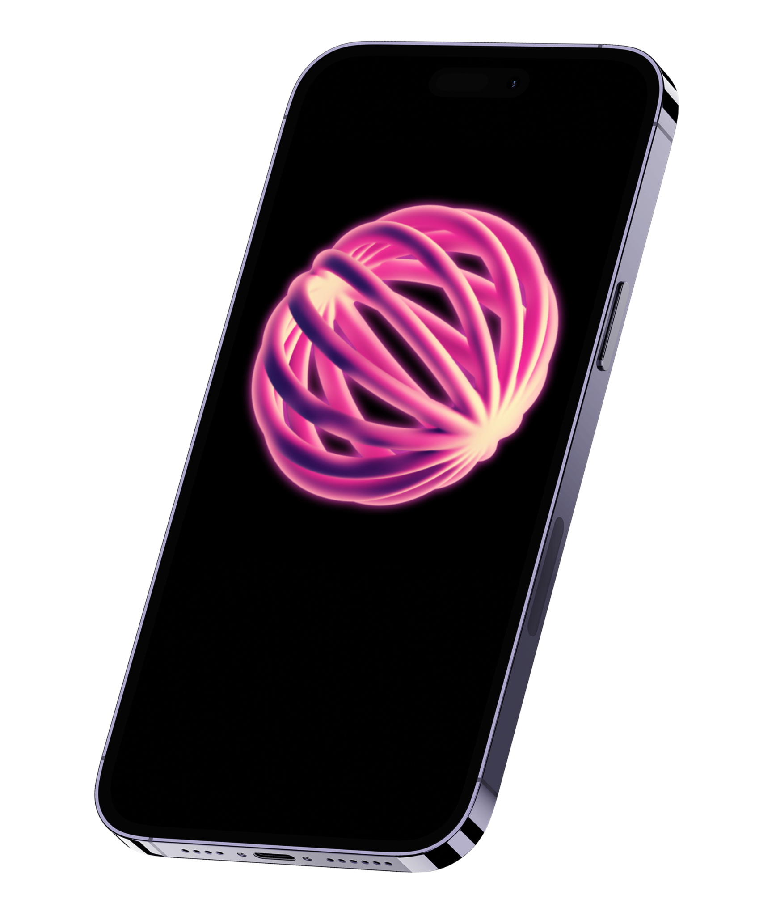
Introduction
Abstract
Team
User Stories
Constraints
Progress

Slide 3

Introduction

Slide 4



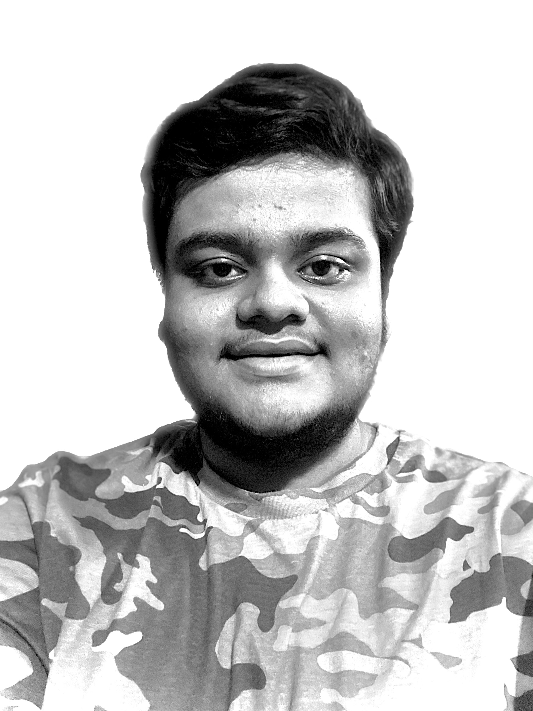
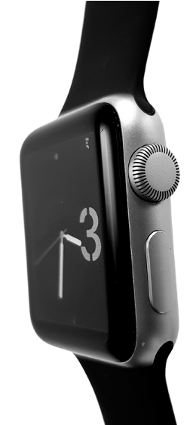




Data-driven insights
Intelligent analytics
Personalized daily goals
Location aware
Welcome
Apple HealthKit enabled
I’m Aayush, and I'll be sharing with you my idea for what AquaCoach is. Follow me at @aayushkeshari on GitHub to learn more.
AquaCoach is a smart hydration tracking application designed to encourage healthy water-intake habits through real-time analytics and adaptive reminders.
Workout Companion
Student-made
40+
beverages
Health and Food Conscious
Environmentally Aware

Slide 5

Project Abstract

Slide 6
AquaCoach is to help users monitor, optimize, and personalize daily water intake using intelligent analytics and adaptive reminders. We aim to promote healthier hydration habits through intuitive design, predictive goal setting, and data-driven insights.

Slide 7
Team

Slide 8
Team Member: Aayush Keshari (solo developer)
Email: kesharah@mail.uc.edu
GitHub Repo: github.com/aayushkeshari/AquaCoach
Advisor: Aishwarya Keshari (Amazon), Shivani Gupta (Amazon)

Slide 9

User Stories

Slide 10
The AquaCoach app is designed with diverse users in mind. For example, a health-conscious individual wants to log their daily water intake to consistently track progress toward personalized hydration goals. A busy student seeks timely reminders throughout the day to ensure they stay properly hydrated despite a hectic schedule. Meanwhile, an athlete desires an intelligent system that dynamically adjusts hydration targets based on factors such as weather conditions and physical activity levels. Together, these perspectives illustrate AquaCoach’s commitment to accessibility, adaptability, and user-centered design that supports healthy hydration habits for every lifestyle.

Slide 11
Design Diagrams

Slide 12
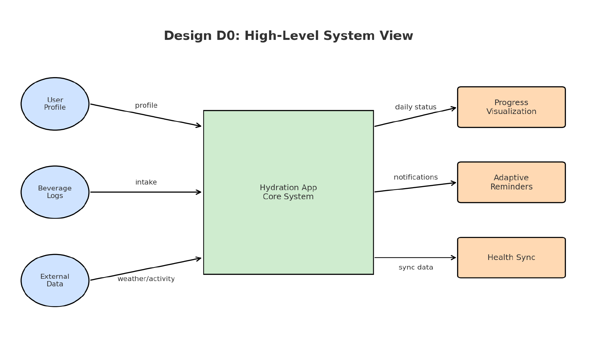
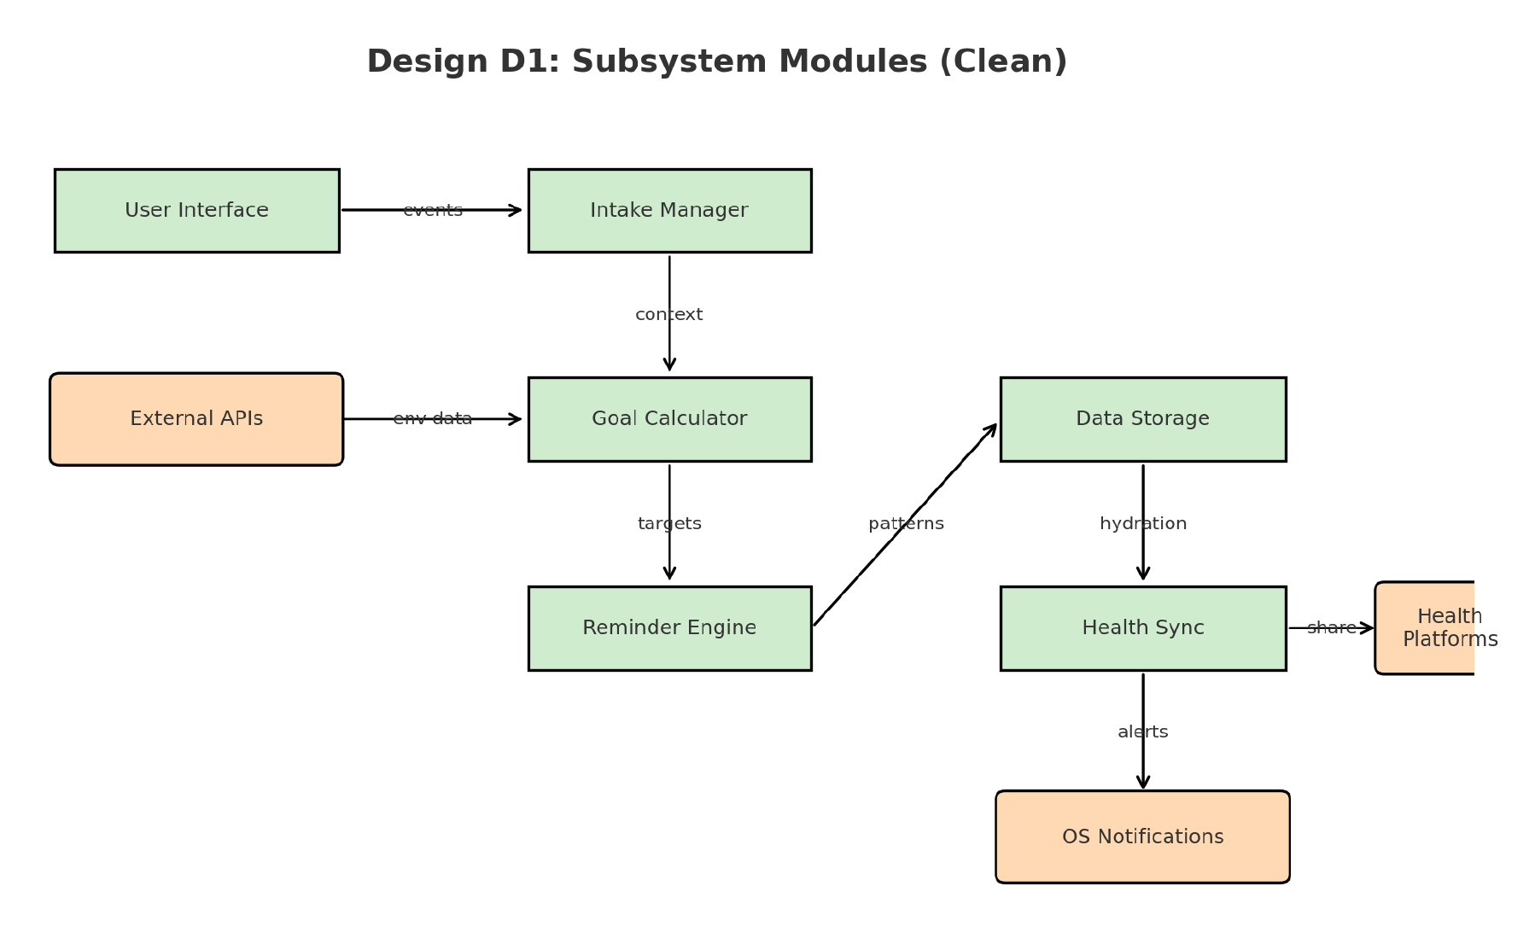
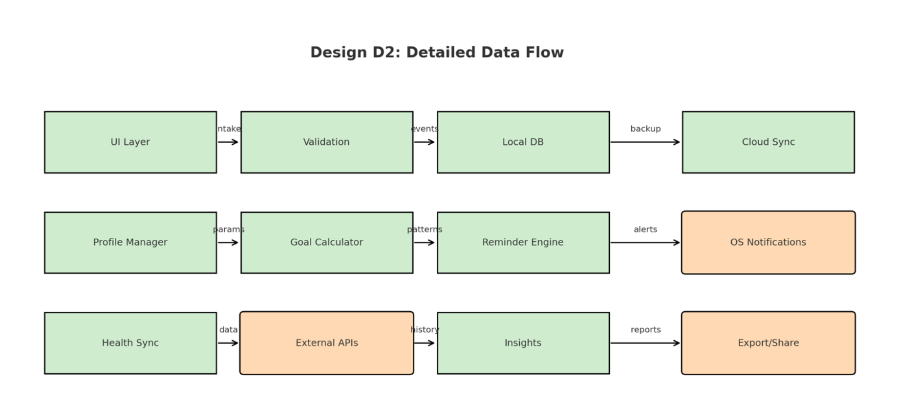

Slide 13

Constraints

Slide 14
AquaCoach operates under several real-world constraints:
Economic: Uses free APIs, SQLite, and open-source frameworks due to no external funding.
Ethical: Protects user privacy by encrypting local data and minimizing personal identifiers.
Security: Follows secure data-sharing standards with Apple HealthKit and iCloud backup encryption.
Diversity & Cultural Impact: Inclusive UI supports varied languages, climates, and hydration patterns.
These factors shape design decisions and prioritize responsibility alongside functionality.

Slide 15

Progress

Slide 16
Current Status:
✅ Completed requirements and architecture designs
✅ Defined user stories and project workflow
✅ Created UI/UX wireframes and early prototype screens
✅ Established GitHub repo with structured documentation and deliverables
🔄 Preparing to begin module development (Intake Manager, Goal Calculator, Reminder Engine)

Slide 17

Expected Accomplishments

Slide 18
➡️ Deliver a fully documented system architecture and requirements specification.
➡️ Produce functional UI prototype demonstrating logging and goal features.
➡️ Complete task list if needed to add newer tasks, and effort matrix documentation.
➡️ Finalize constraints analysis and GitHub repository for continuation in Spring.

Slide 19
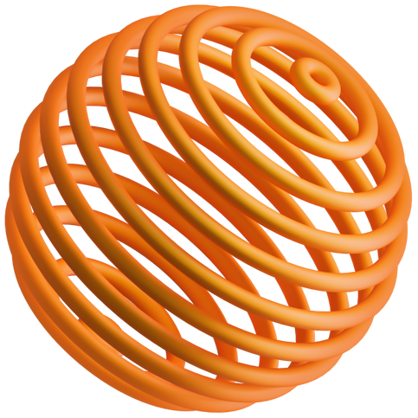
Effort Allocation

Slide 20
Since the project is individual, I am responsible for all phases of development.
Key Roles:
System Architecture & Design (10%)
UI & Prototype Development (15%)
Module Implementation (Intake, Goal, Reminder, Storage, Apple HealthKit) (40%)
Integration & Testing (25%)
Documentation & Presentation (10%)

Slide 21

Demo

Slide 22
Planned CEAS Expo Demo:
➡️ Live demonstration of hydration logging and goal calculation.
➡️ Real-time hydration insights based on activity and weather.
➡️ Interactive reminder system with OS-level notifications.
➡️ Dashboard display with visual progress and trend charts.
Deliverables Showcased:
➡️ Working app prototype, poster presentation, and technical documentation.

Slide 23
Contact me!
350 Straight St, Cincinnati, OH-45219
kesharah@mail.uc.edu
@aayushkeshari (GitHub)

Slide 24
“I skate to where the puck is going to be, not where it has been.”
- Wayne Gretzky

Slide 25
Thanks!

